Slide 1
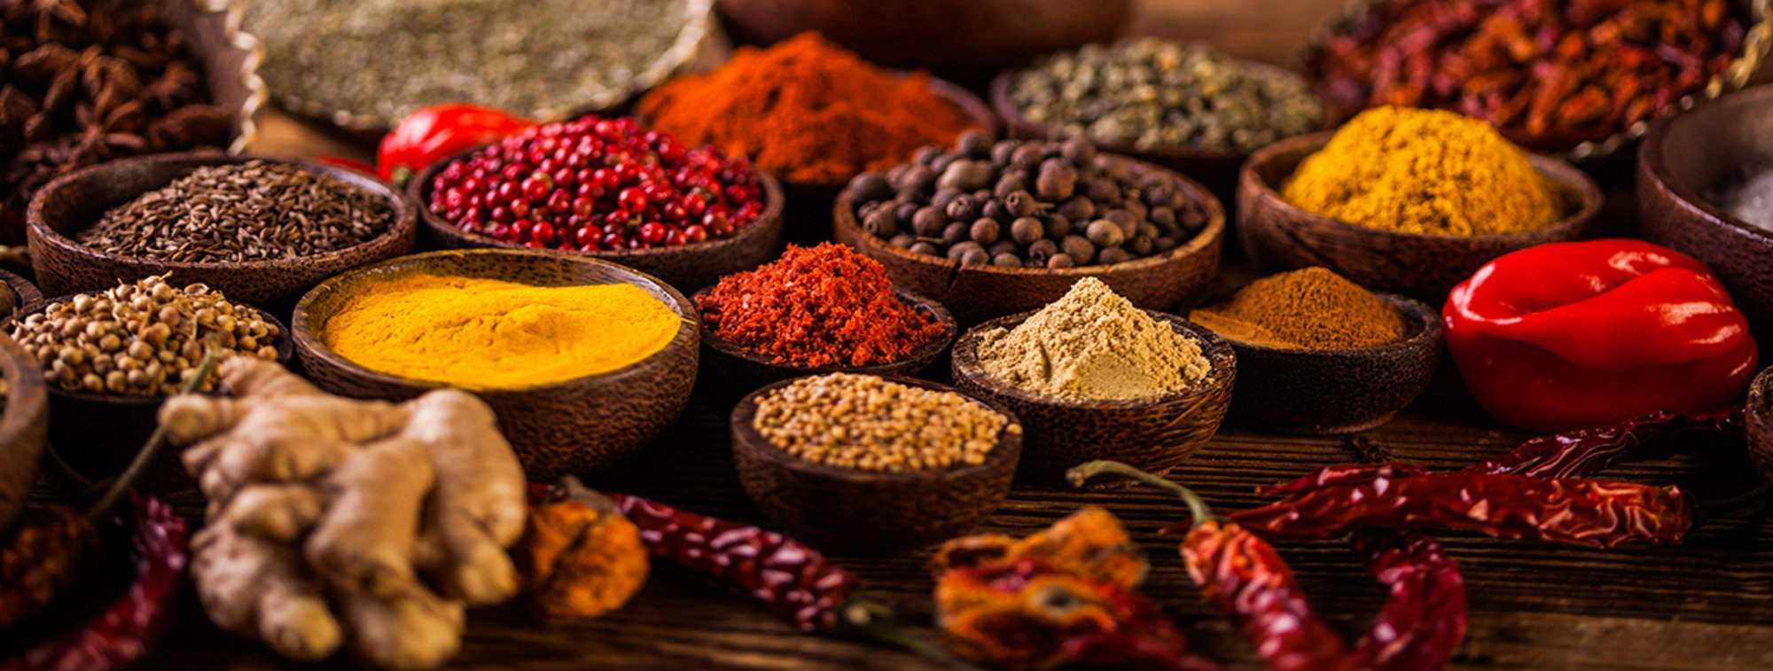
BON VIVEUR
FOOD IS HAPPINESS
Sravya Bussoli
Sravya Garlapati
Harshitha Mandru
Anuradha Vishwapriya Niradi

Slide 2
PROJECT DESCRIPTION
Bon viveur – person who loves food.
Home food away from home.
Customers can order home food online.
The families who want to sell the food login as vendors and they sell the home made food.
The website is designed for Indian cuisine and works for Texas.

Slide 3


Slide 4
TECHNOLOGIES USED
HTML 5
CSS
MYSQL
PHP

Slide 5
MEETING MINUTES
August 29, 2019 (Class) | Project idea and approval
September 3, 2019 (Class) | Project overall plan
September 5, 2019 (Class) | Design and assignment of roles
September 8, 2019 (2 hrs) | Discussion about deliverable 1 and its content-flowchart, Gantt chart, project plan
September 10, 2019 (Class) | Deliverable 1 document and presentation discussion

Slide 6
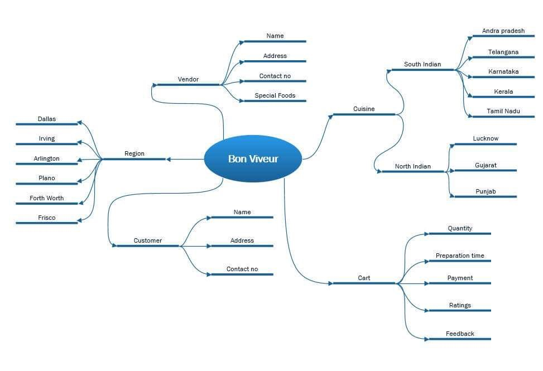
INITIAL PLAN

Slide 7
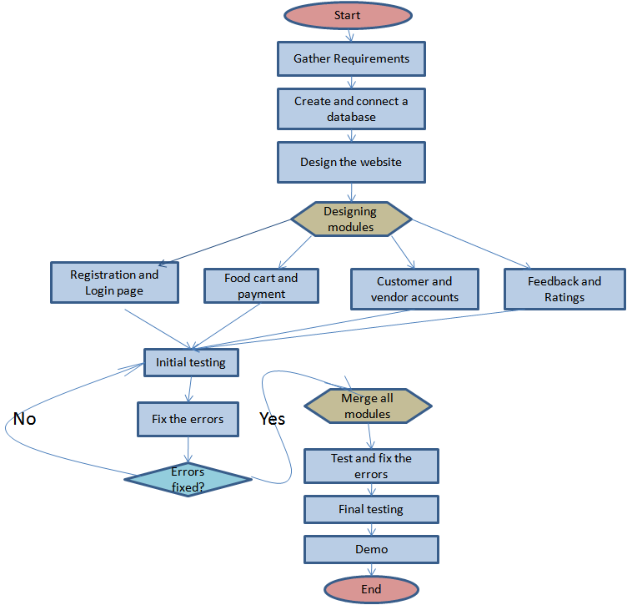
PROJECT FLOW

Slide 8
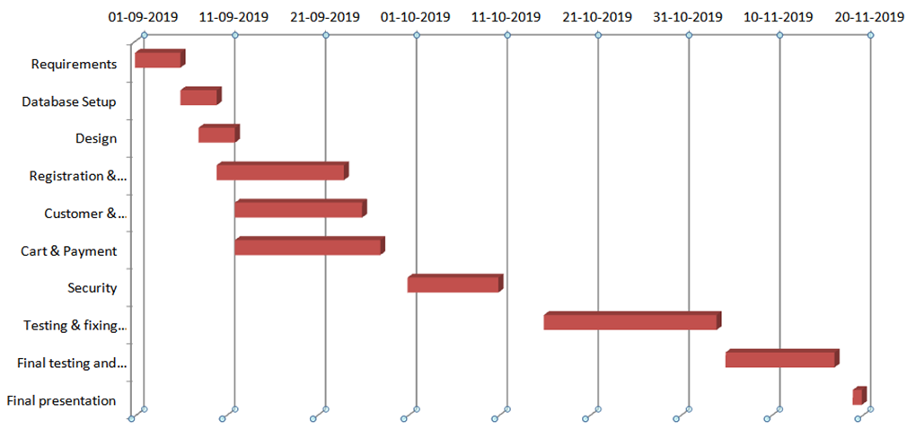
GANTT CHART

Slide 9
RISK MANAGEMENT
Risk | Monitor | Evaluation Contingency Plan
Exceeding timeframe | Checking if everyone is completing tasks on time | Staying ahead of time with proper plan and testing often to avoid delay in last minute
Scaling | Checking if any addition of features take more time and result in complex system | In case of addition of features, check for need and how much it affects the whole system
Change of requirements | Check if the features have extra requirements periodically | Evaluate the requirements and finding out if they are really necessary before adding so that it doesn't end up with too many by the end of the project

Slide 10
TEAM MEMBERS AND ROLES
Anuradha - Repository creation, documentation, database setup, customer and vendor account module code, cart and payment module code
Harshitha – Gathering requirements, presentations, customer and vendor account module code, cart and payment module code
Sravya G - Gathering requirements, registration and login module code, security features for website
Sravya B - Presentations, registration and login module code, security features for website
Initial testing, fixing errors in respective modules and final testing will be done by all the team members.

Slide 11
Thank you!

